Slide 1
STA6704 Semester Project
Benjamin Garcia
April 21st 2025
University of Central Florida

Slide 2
Overview
Introduction
The Data
Preprocessing
Visualizations & Predictor Analysis
Supervised Learning
Unsupervised Learning
Bag-of-Words
Conclusion

Slide 3
Introduction
Dataset examined consisted of loan data
Individuals applying for a loan were either rejected or approved
What does the data tell us about the applicants that were approved vs rejected?

Slide 4
The Data
Pulled from Kaggle
The original dataset consisted of 24,000 observations and 7 variables
Variable names include Text, Income, Credit Score, Loan Amount, DTI Ratio, Employment Status, and Approval

Slide 5
Preprocessing
Variables Employment Status and Approval were set to binary 0/1 variables
Class imbalance was corrected for target variable Approval
Continuous variables were scaled
Since not approved was so infrequent, the final dataset consisted of 7,866 observations

Slide 6
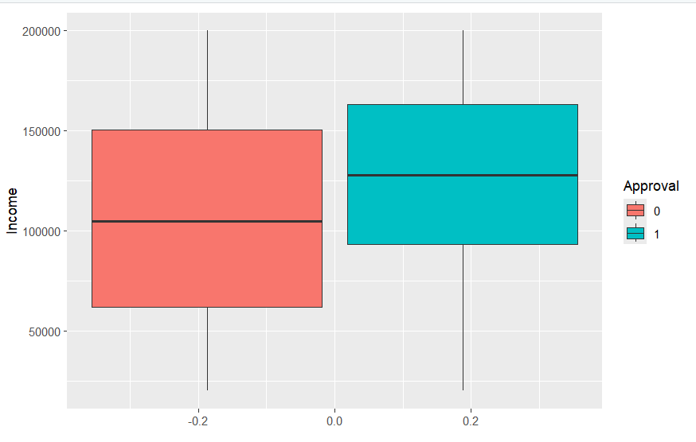
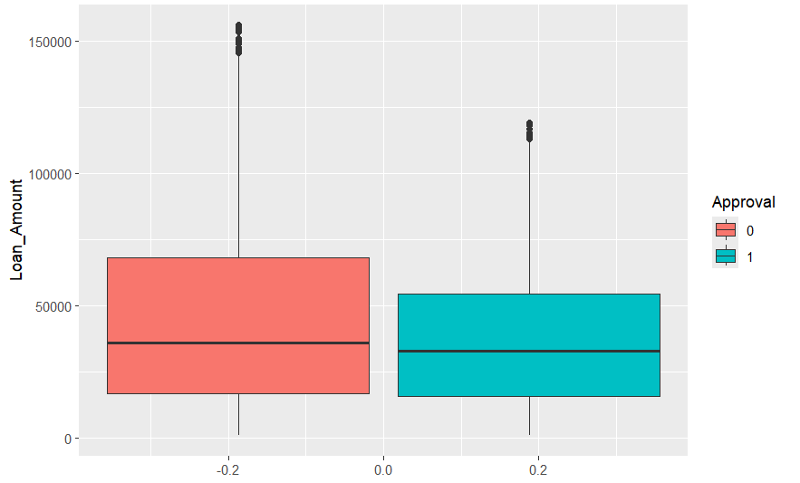
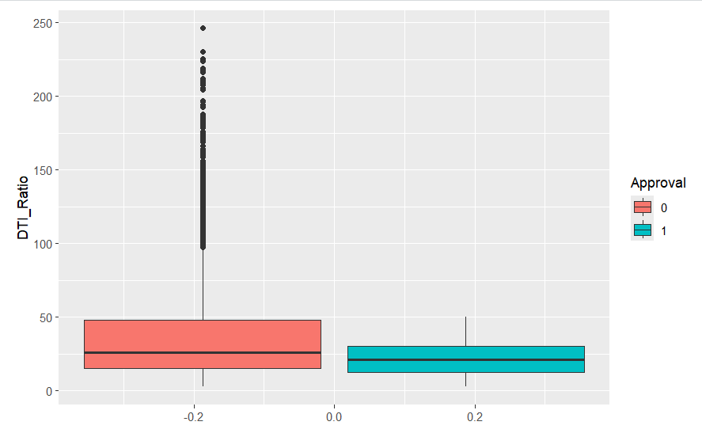
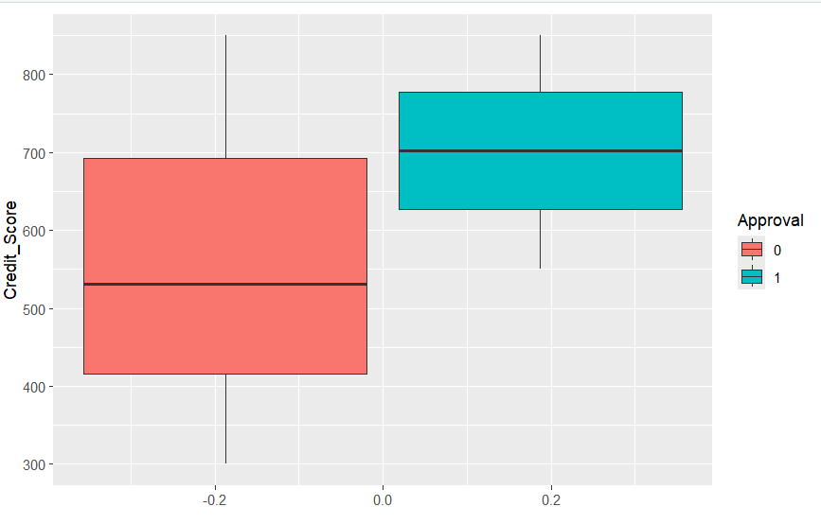
Visualizations

Slide 7
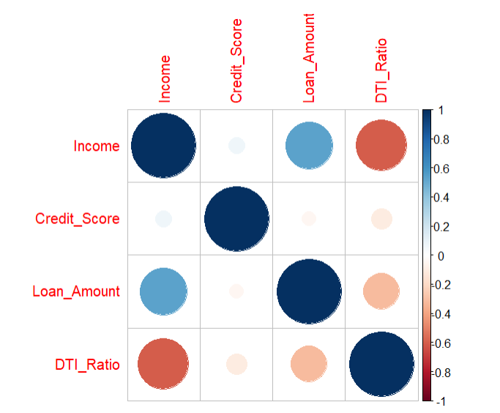
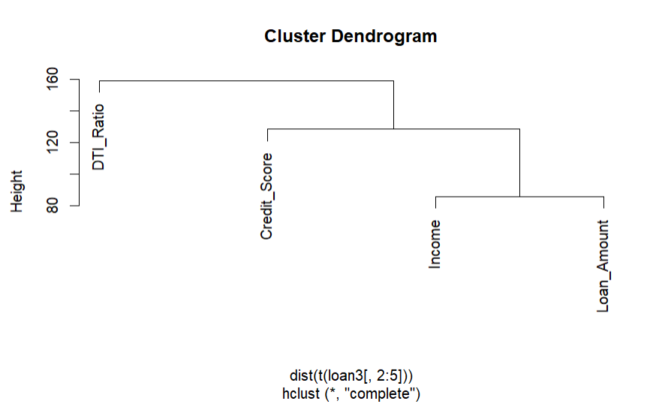
Predictor Analysis

Slide 8
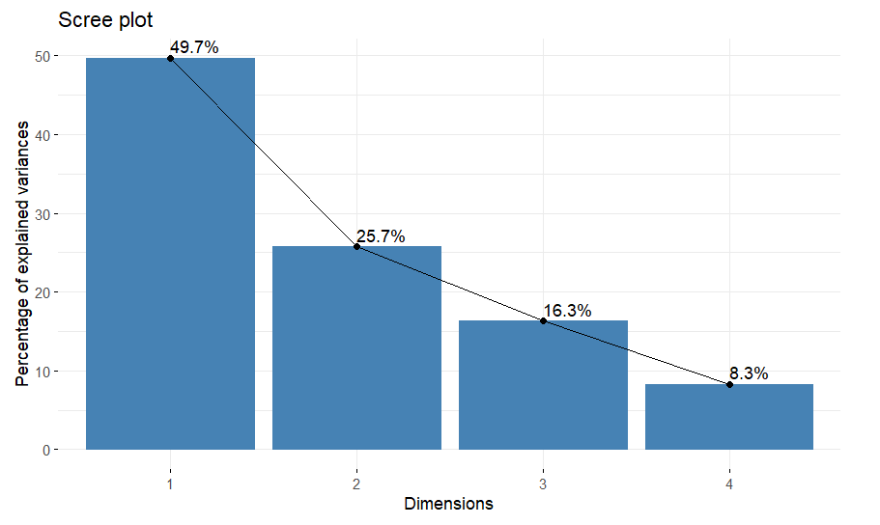
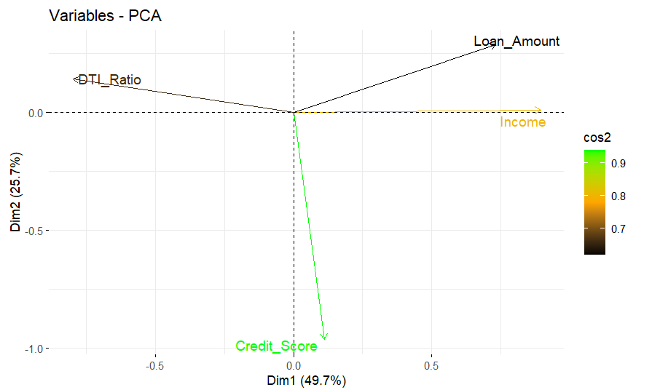
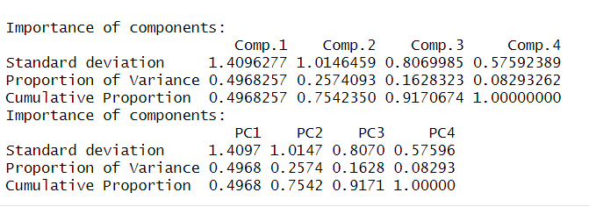
Predictor Analysis

Slide 9
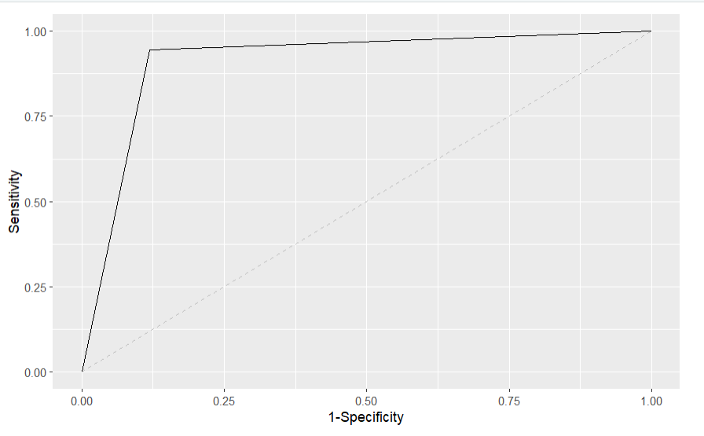
Supervised Learning: Logistic Regression
Variable selection indicated all variables should be left in the model.
Employment Status only variable not significant
AIC: 2017
Accuracy: 91%

Slide 10
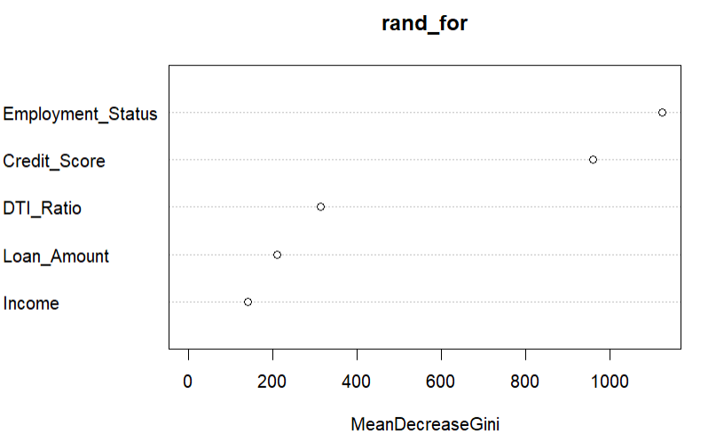
Supervised Learning: Random Forest
Used same predictors as logistic regression
Employment Status had the highest variable importance
Accuracy: 99%

Slide 11
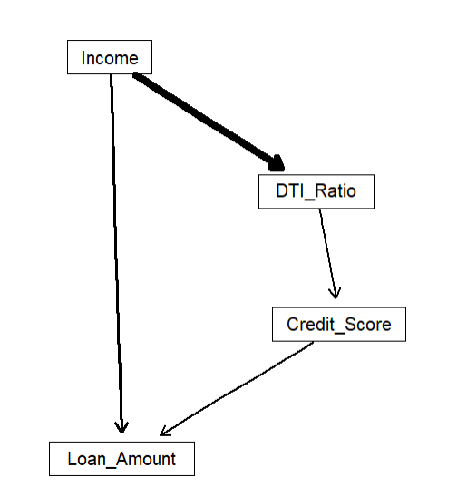
Unsupervised Learning: Bayesian Model
Used scaled continuous variables
Used the hill-climbing algorithm
MSE: .71

Slide 12
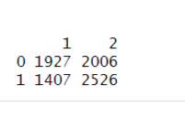
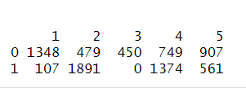
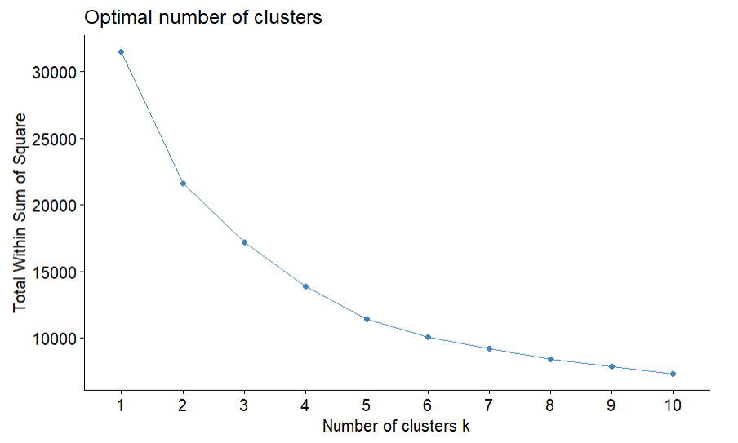
Unsupervised Learning: K-means Clustering
Used K-means clustering for k = 2 and k = 5

Slide 13
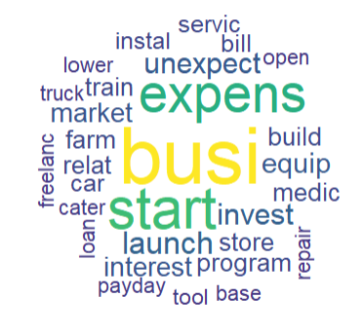
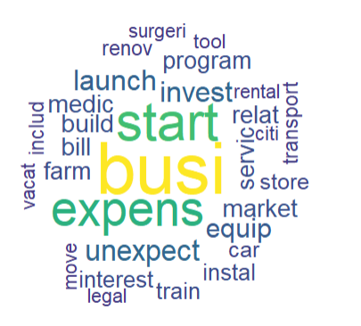
Bag-of-Words
Split the data into approved loan applications and not approved loan applications to see if the words used in the purpose for the loan differed
Word cloud approved loans
Word cloud not approved loans

Slide 14
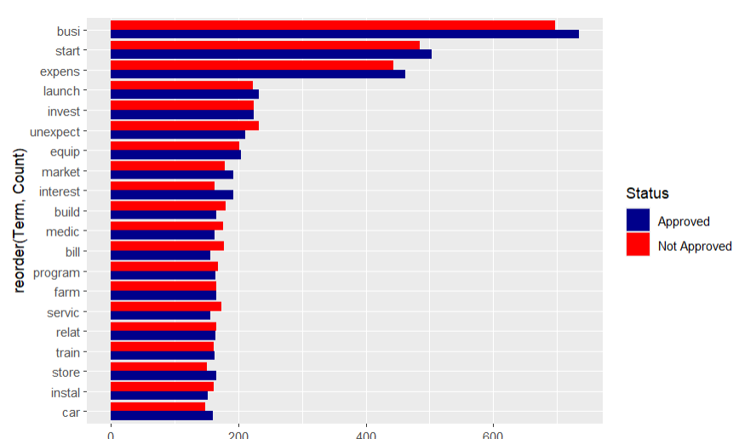
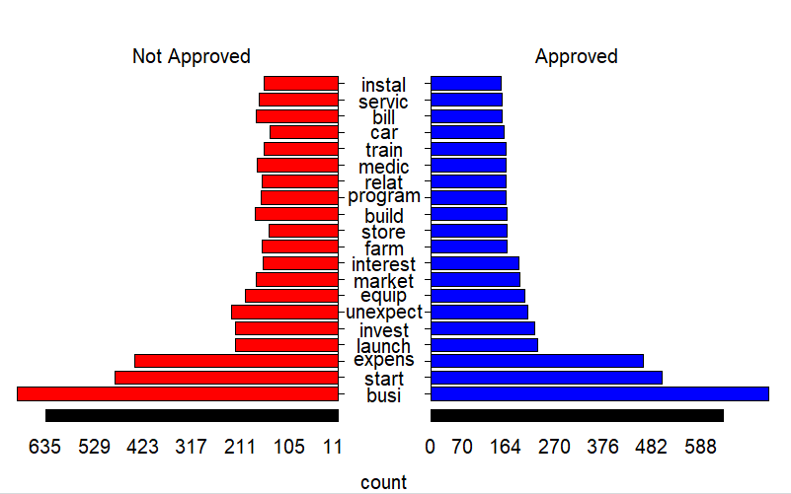
Bag-of-Words

Slide 15
Conclusion
Bag-of-words did not result in any ability to know if the loan was approved or not
Unsupervised learning techniques can help us understand the relationship between the predictors
Random forest outperformed logistic regression, but both models had over 90% accuracy in predicting is a loan was approved or not
In the various methods used the predictors varied in which were important for the model

Slide 16
Thank You

